Slide 1
Retail analytics
-Parth Umrawala
-10/05/2025

Slide 2
objective
Explore the dataset using visual analytics (charts and graphs) to uncover patterns, outliers, and noteworthy trends.
To analyze chips’ retail data in order to understand customer purchasing behavior and uncover insights that can form a targeted sales strategy.
Examine total sales figures, key drivers of sales, and segments contributing the most to revenue.
Explore the dataset using charts and graphs to uncover any patterns, outliers, and noteworthy trends.
The client is particularly interested in:
Understanding chip purchasing behavior across different customer segments.
Gaining insights that can guide segment-focused marketing.

Slide 3
Dataset Overview
Took two datasets (Transaction & customer) from the Quantium data analytics job simulation on https://www.theforage.com/
Customer data info:
Size: 3 columns ; 72.6k rows
Columns:
LYLTY_CARD_NBR: Loyalty card number
LIFESTAGE: Life-stage of customer
PREMIUM_CUSTOMER: Customer segment (Budget / mainstream / premium)
Transaction data info:
Size: 8 columns ; 265k rows
Columns:
DATE: Transaction date
STORE_NBR: Store number
LYLTY_CARD_NBR: Loyalty card number
TXN_ID: Transaction id
PROD_NBR: Product number
PROD_NAME: Full name of the product along with weight in grams
PROD_QTY: Quantity of the product
TOT_SALES: Total sales (per transaction)

Slide 4
Pre-processing summary
Date formatting: Converted serial number format to dd/mm/yyyy format
Outlier removal: Excluded an outlier in PROD_QTY (value: 200) to avoid skewing results.
Text cleaning: Trimmed whitespace from PROD_NAME
Weight extraction:
Extracted weight (grams) from PROD_NAME into new column: WEIGHT_IN_GRAMS
Binned weights into a new column: PACK_SIZE:
70-100g: Small
101-200g: Medium
201-300g: Large
301-380g: Extra-large
Brand name extraction: Derived BRAND from PROD_NAME
Finally, merged the transaction & customer data for unified analysis and visualization.

Slide 5
Tools & techniques used
Excel: Used for fixing formats, removing outliers and text cleaning.
Python:
Used for creating 3 new features: WEIGHT_IN_GRAMS, PACK_SIZE and BRAND.
Used for Hypothesis Testing to check statistical significance
Used for Affinity Analysis
Used for joining transaction & customer data for visualization and further analysis.
Tableau: Used for creating visualizations from the combined data

Slide 6
Visualizations & insights
Section 1: Time based trends
Section 2: Sales analysis
Section 3: Customers per life-stage and customer segment
Section 4: Average units & price analysis

Slide 7
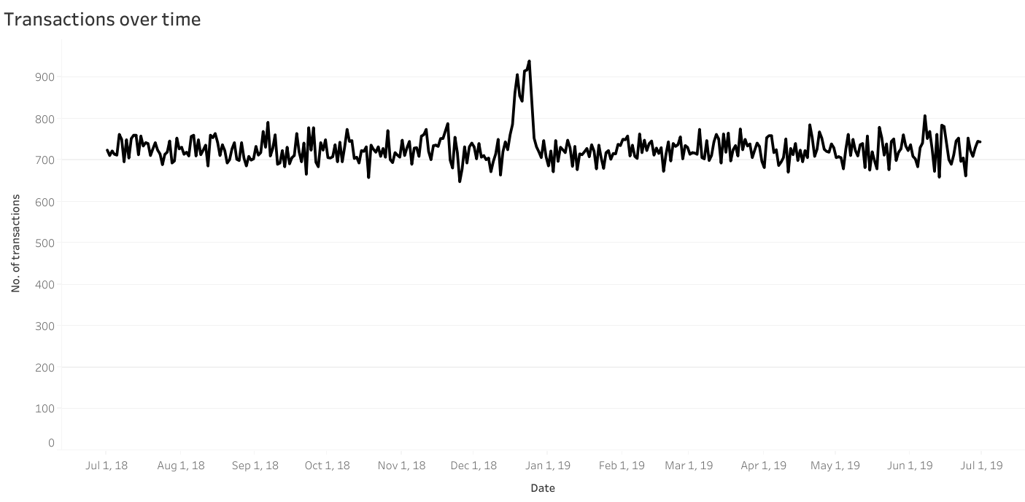
Time based trends
We can see that there is a big leap in transactions in December. Let’s zoom in on that region.

Slide 8
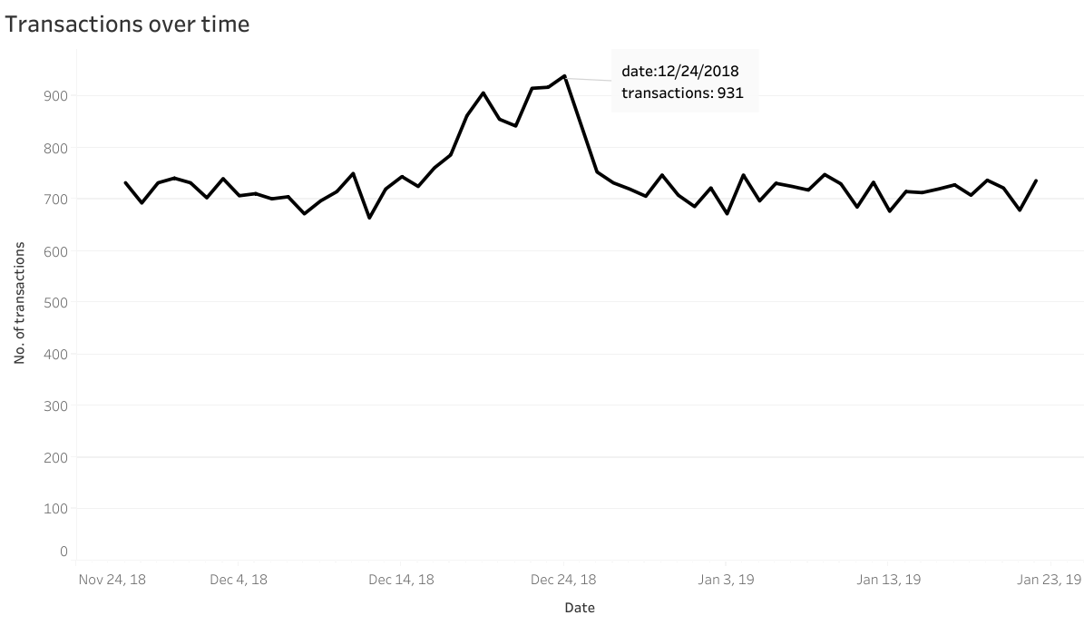
We can see that the increase in transactions occurs just before Christmas (24th dec) and that it significantly drops on Christmas day itself, which is due to most shops being closed on Christmas.

Slide 9
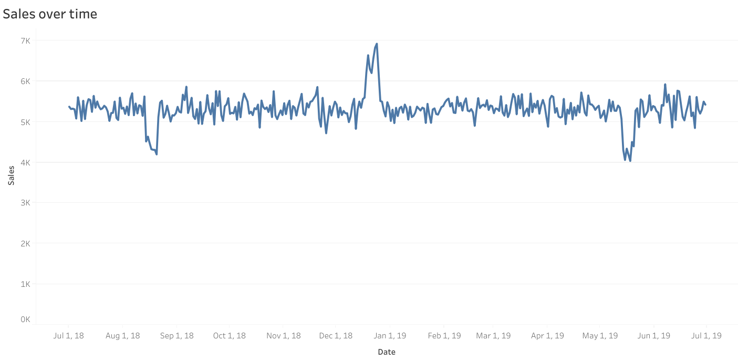
This is sales over time for 1 year (July 2018 – July 2019) Lets examine yearly sales now.

Slide 10
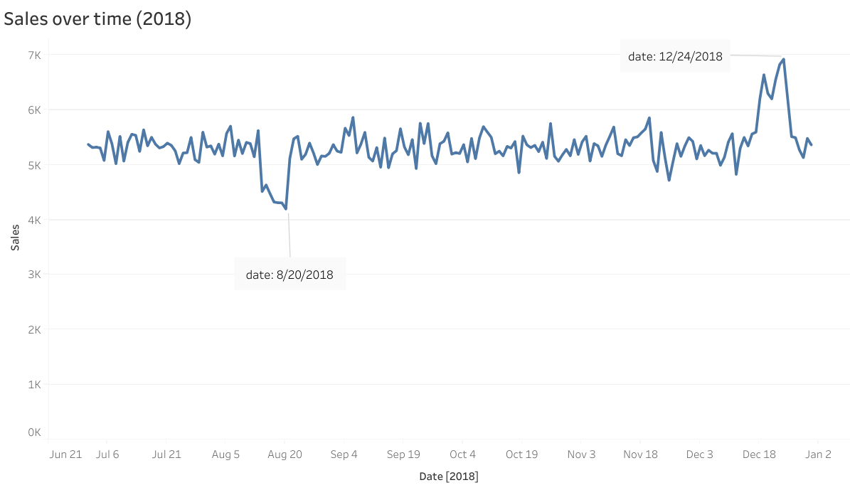
Here, the decline in sales around August 20th could be due to either festivals or several stores being closed that day for maintenance, etc…The exact reason is unknown for now.
And the sudden increase on December 24th is due Christmas being next day. We already observed this previously.

Slide 11
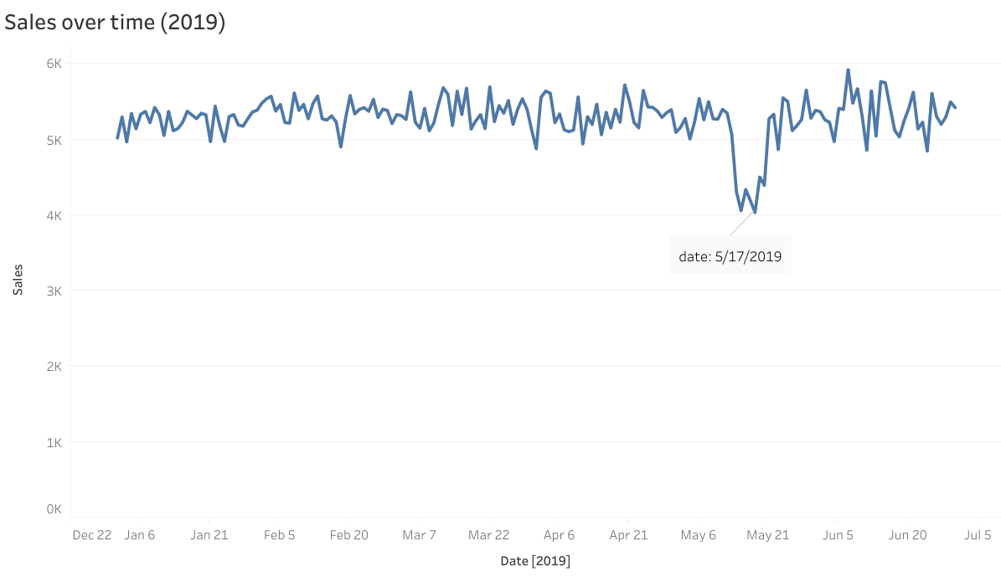
Once again, the decline in sales around May 17th could be due to either festivals or several stores being closed that day for maintenance, etc…The exact reason is unknown for now.

Slide 12
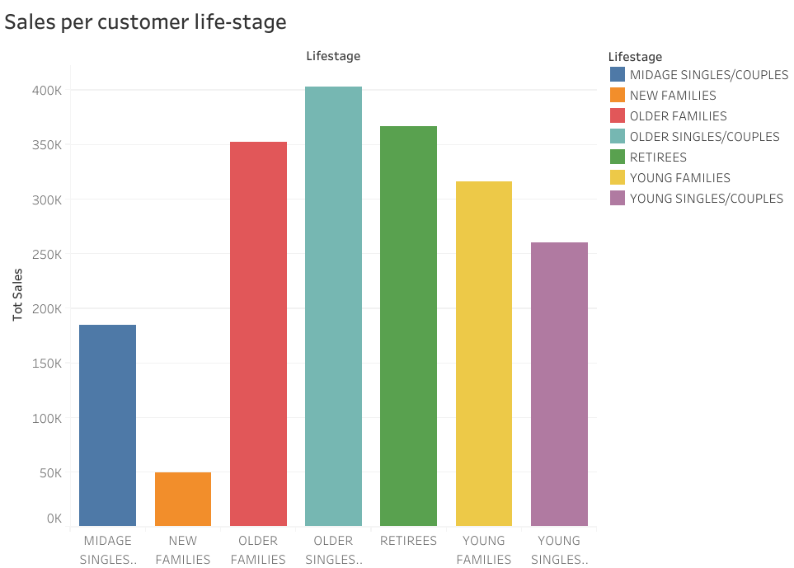
Sales analysis
Here, we can see that older people contribute the most to sales with older singles/couples life-stage contributing the most while new families life-stage contributes the least.

Slide 13
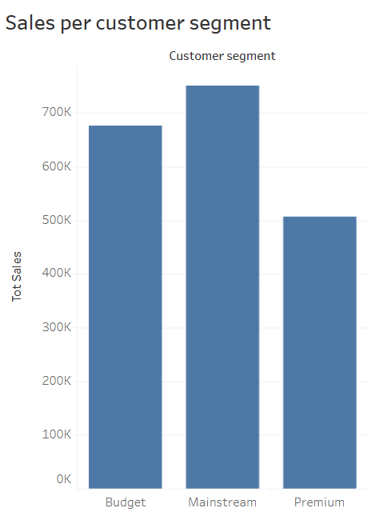
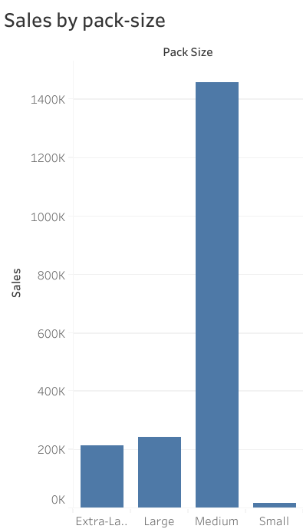
Mainstream customer segment contributes the most to sales.
Medium pack size (101-200g) contributes highest to sales.

Slide 14
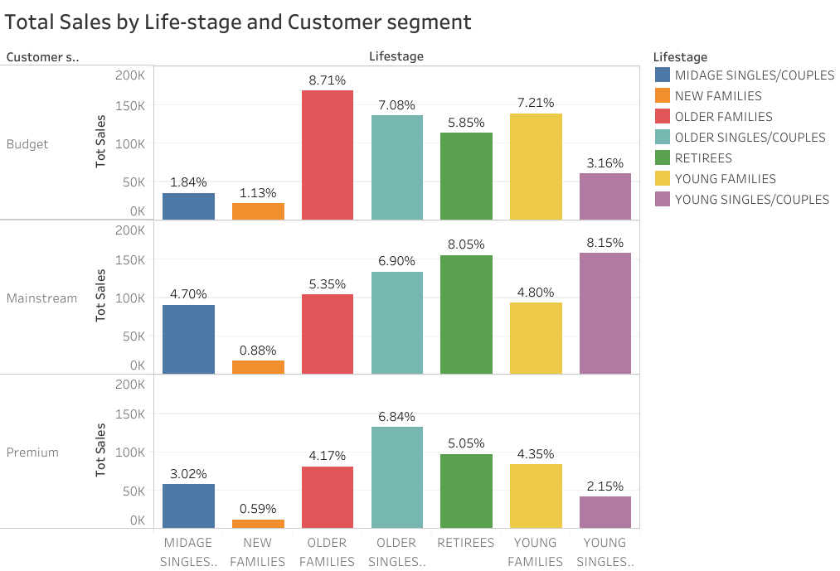
Here we calculated total sales by Life-stage and customer-segment and plotting the split by these segments to describe which group contribute most to chip sales.
Sales are coming mainly from Budget-older families, Mainstream-young singles / couples, and Mainstream-retirees.
In next section (Number of customers), we’ll see if higher sales are because of there being more number of customers in those groups.

Slide 15
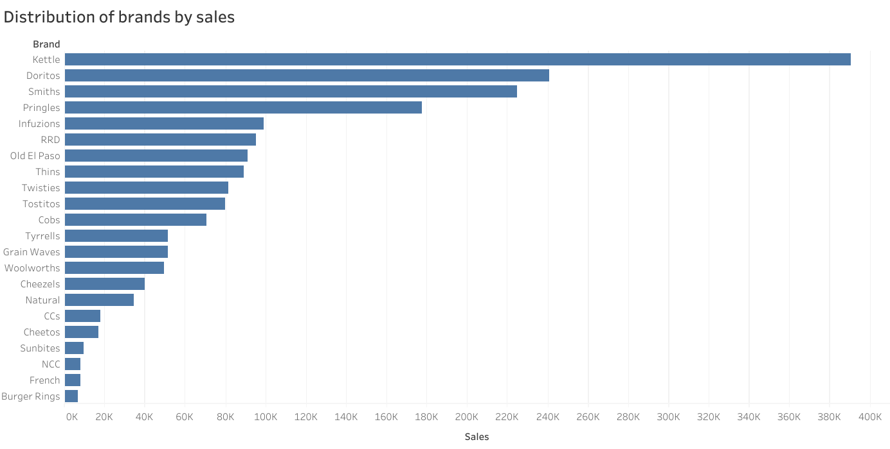
The brand Kettle contributes highest to sales followed by Doritos, Smiths, Pringles and Infuzions.
While the lowest being Burger rings, French fries potato chips, NCC, Sunbites and Cheetos.

Slide 16
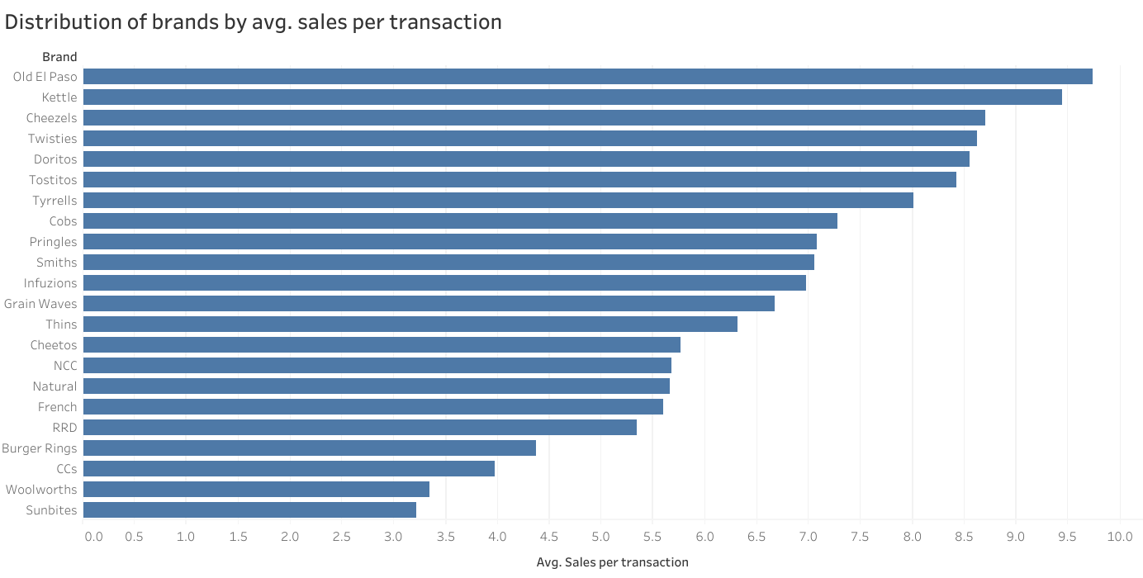
Old El Paso leads with the highest average sales per transaction, slightly below 10 units.
Kettle, Cheezels, Twisties, and Doritos also perform strongly, all averaging over 8 units per transaction.
A clear gap exists between the top-tier brands (Old El Paso to Tyrrells) and the rest, indicating potential differences in customer preference or product bundling

Slide 17
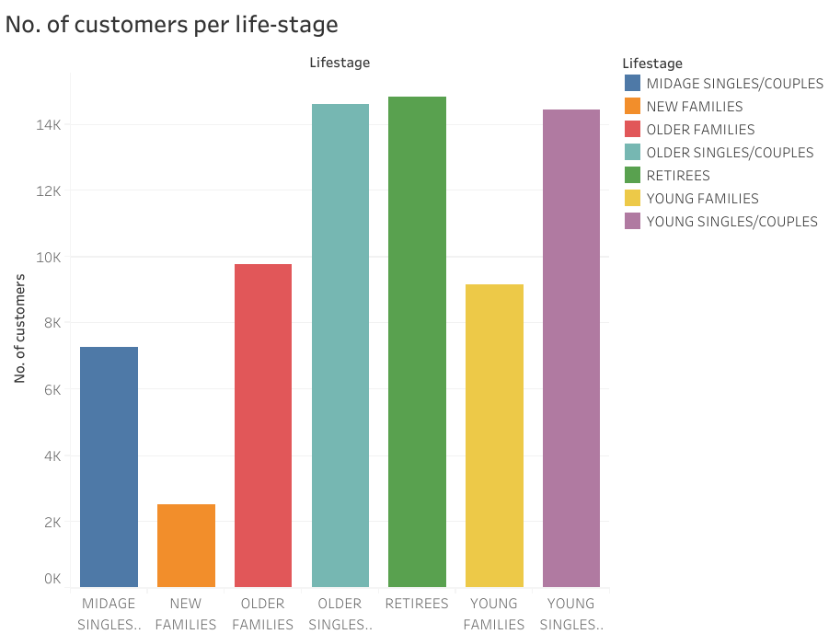
Customers per life-stage and customer segment
There are more number of customers in older singles / couples, retirees and young singles / couples life-stages.
This graph is a bit different than the sales per life-stage one. In that we saw that most sales were coming from older singles/ couples, retirees and older families, whereas here, we see that there are significantly less number of customers in the older families life-stage.
Also, there are lots of customers in young singles / couples life-stage, but that group wasn’t a significant contributor to sales.

Slide 18
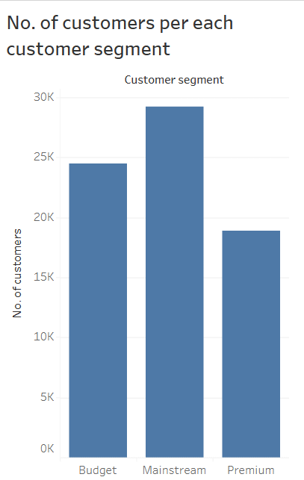
Similar to the sales per customer segment graph, there are more number of mainstream customers followed by budget and premium customers.
Next we will see number of customer per life-stage and customer segment so we can see a detailed distribution of customers across each group (eg.: proportion of customers that fall in budget & older families, mainstream & retirees, etc…)

Slide 19
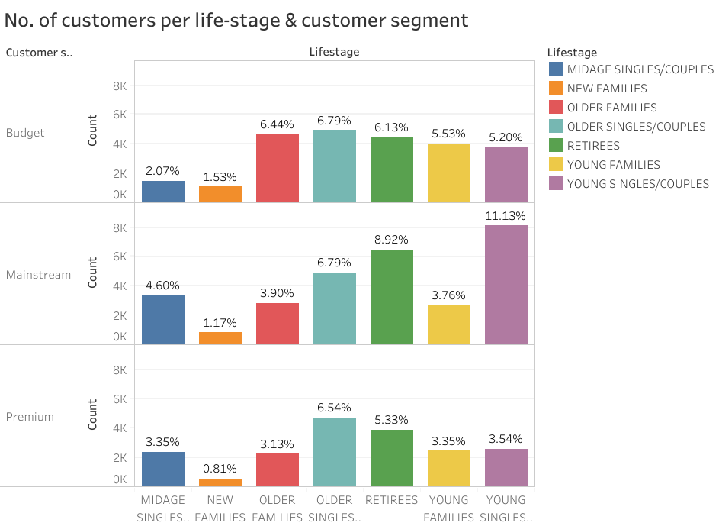
There are a greater number of customers in the Mainstream-young singles / couples and Mainstream - retirees group. This contributes to there being more sales in those groups.
But there are lesser number of customers in the Budget-Older families group. So, number of customers is not a major driver of high sales for this group! (This group had the highest proportion of sales out of all groups!)
Higher sales may also be driven by more units of chips being bought per customer. Let’s have a look at this next.

Slide 20
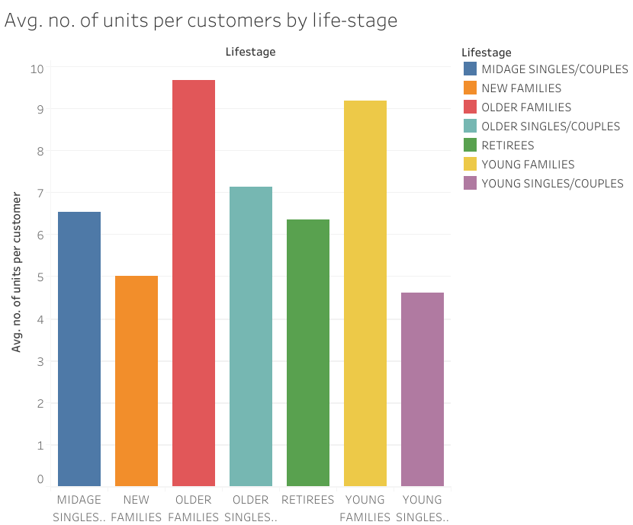
Average units & price analysis
We can see that on average, older families buy more packs/units per customer than any other life-stage. Which is the reason for higher sales in the Budget-older families group.
Next, we’ll see the average price per unit chips bought for each group as this is also a driver of sales.

Slide 21
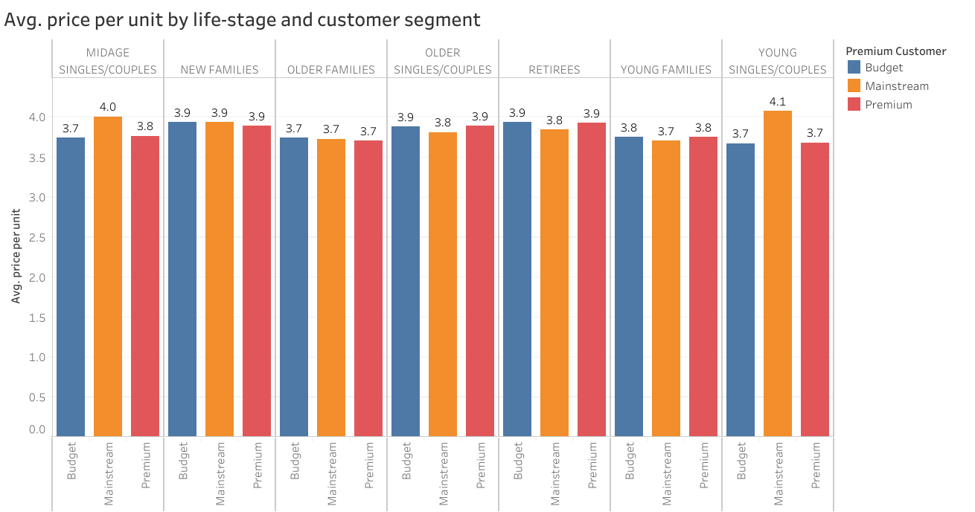
Mainstream mid-age and young singles/ couples are more likely to spend more on a pack of chips than their budget or premium counterparts. Premium consumers often choose healthier snacks and usually purchase chips for social occasions rather than personal use. This is also reflected in the lower number of premium mid-age and young singles/ compared to mainstream.

Slide 22
As the difference in average price per unit isn’t large between mainstream and budget & premium segments for these life-stages: midage singles/couples , young singles/couples, we checked if this difference was statistically different using hypothesis testing.
An independent 2-sample t-test in python gave us a p value ~ 0.02. Which is less than 0.05. So, we can conclude that, the avg. price per unit for mainstream segment is significantly higher than budget and premium segments for the following life-stages: midage singles/couples & young singles/couples.

Slide 23
Affinity analysis results
We can target customer segments like Mainstream-young singles/couples that contribute high to sales in order to retail them. So, we performed affinity analysis to find out if they tend to buy a particular brand of chips & a particular pack-size.
The results from affinity analysis (performed in python) are as follows:
Mainstream-young singles/couples are 23% more likely to purchase chips of Tyrrells brand compared to the rest of the population
Mainstream young singles/couples are 56% less likely to purchase Burger Rings compared to the rest of the population
Mainstream young singles/couples are 24% more likely to purchase chips that have extra-large pack size.

Slide 24
Key insights
High sales are coming from these groups:
Budget – Older families
Mainstream – Young singles/couples
Mainstream – Retirees
Sales drivers:
High sales in mainstream-young singles/couples and mainstream-retirees is due to there being more number of customers in those groups.
Midage singles/couples and young singles/couples in the mainstream segment tend to pay more per packet, indicating impulse buying behavior.
Brand & pack-size preference:
Mainstream young singles/couples are 23% more likely to purchase Tyrrells chips than the rest of the population. Also, this segment is 24% more likely to purchase extra-large pack size than the rest of the population.

Slide 25
recommendations
The number of transactions dramatically increases prior to Christmas. So we could Launch promotions and festive campaigns 2–3 weeks before Christmas & holidays to capture sales.
Target Budget – Older families, Mainstream – Young singles/couples, and Mainstream – Retirees with tailored offers and discounts.
On average, older families and young families buy more packs/units per customer so we can introduce bundle offers tailored to those life-stages
Since mainstream young singles/couples are 23% more likely to purchase Tyrrells chips than the rest of the population, so we can do marketing of that brand on young singles and couples, and use channels and messages that fit their lifestyle.
We can add more products of Tyrrells brand to stores in areas where the youth population is high.

Slide 26
Thank you

